Slide 1
Transmission and Markets Activities
Regional Transmission Coordination Task Force
June 24, 2024
Jeff Billinton
Director, Transmission Infrastructure Planning
Milos Bosanac
Manager, Regional Markets Sector

Slide 2
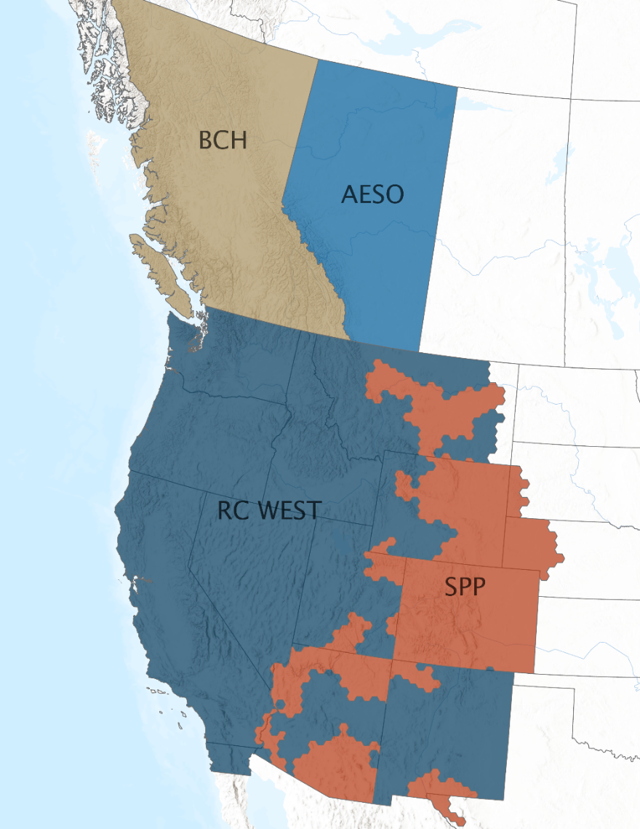
Most of western interconnection is outside an ISO/RTO structure, however coordination exist.
Recorded peak demand: 52,061 megawatts
Serves 80% of California load, plus parts of Nevada
Western Energy Imbalance Market operates in 11 states and British Columbia
40 Balancing Areas and Transmission Operators currently receive reliability coordinator services from CAISO’s RC West
Map from WECC.org
Notes:
if we need to provide credit - Western Interconnection (wecc.org)

Slide 3
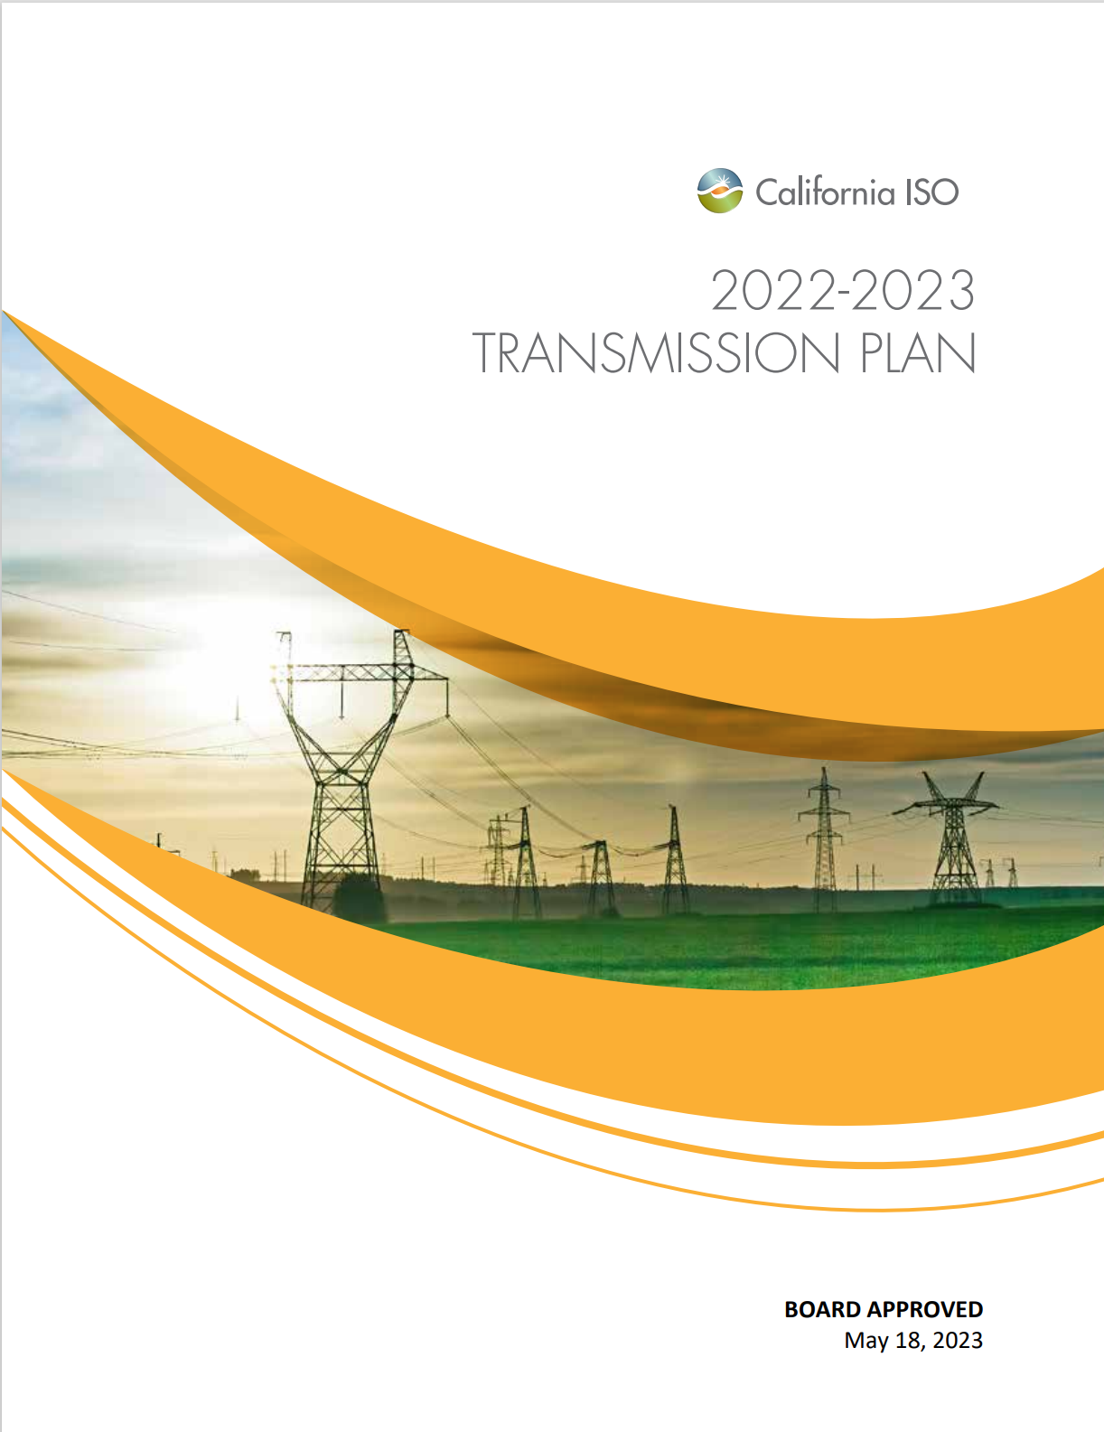
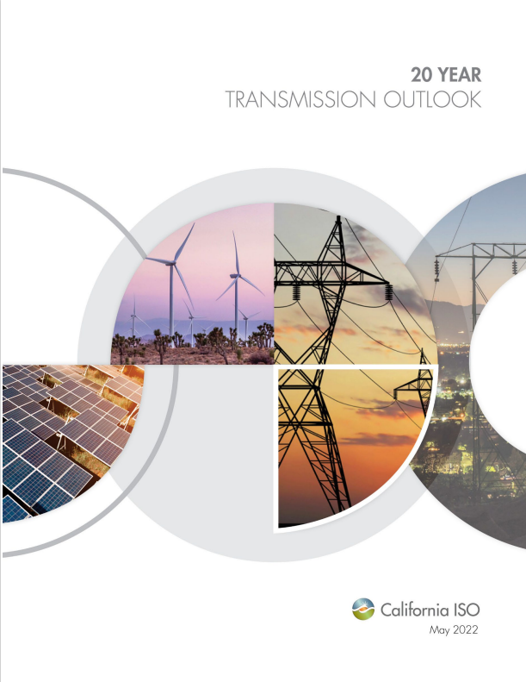
The ISO leads the transmission planning process for our footprint, coordinated with load forecasts from the CEC and resource planning from the CPUC
Annual 10-Year transmission plan is the formal approval document for expansion planning in our footprint
  Ramped from 10 year average of $650 million per year to $3 billion in 2021-2022 plan, $8.1 billion in 2022-2023 plan and $6.1 billion in the 2023-2024 plan
  Responded to accelerating load growth and escalating renewable energy needs
  Focuses on most efficient and effective long term solutions – including Grid Enhancing Technologies and non-wires solutions
20 Year Outlook assesses longer term needs
  First prepared in 2022, being updated in 2024
  Establishes a longer term direction and strategy
  Provides context for nearer term decision
  Informs going-forward resource planning decisions

Slide 4
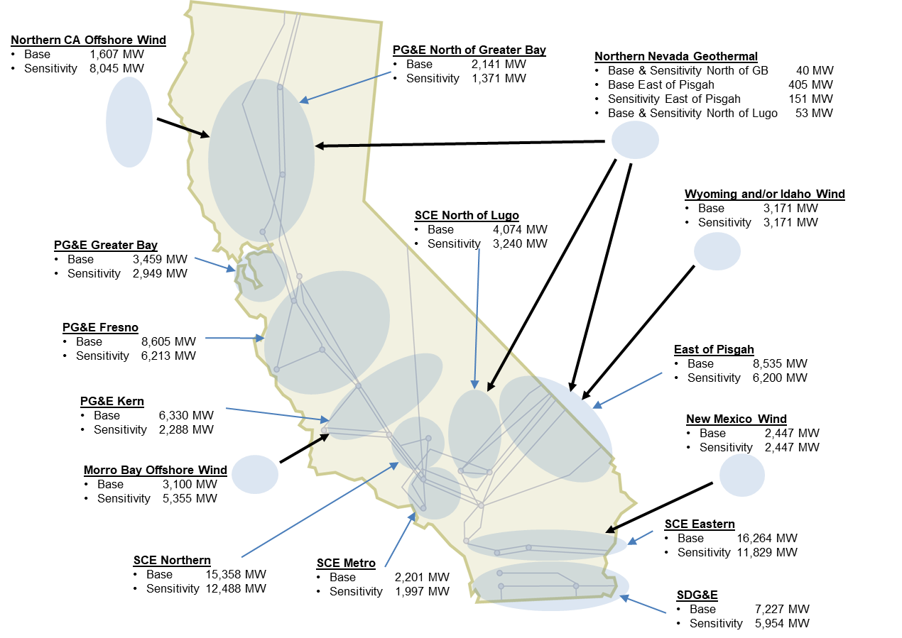
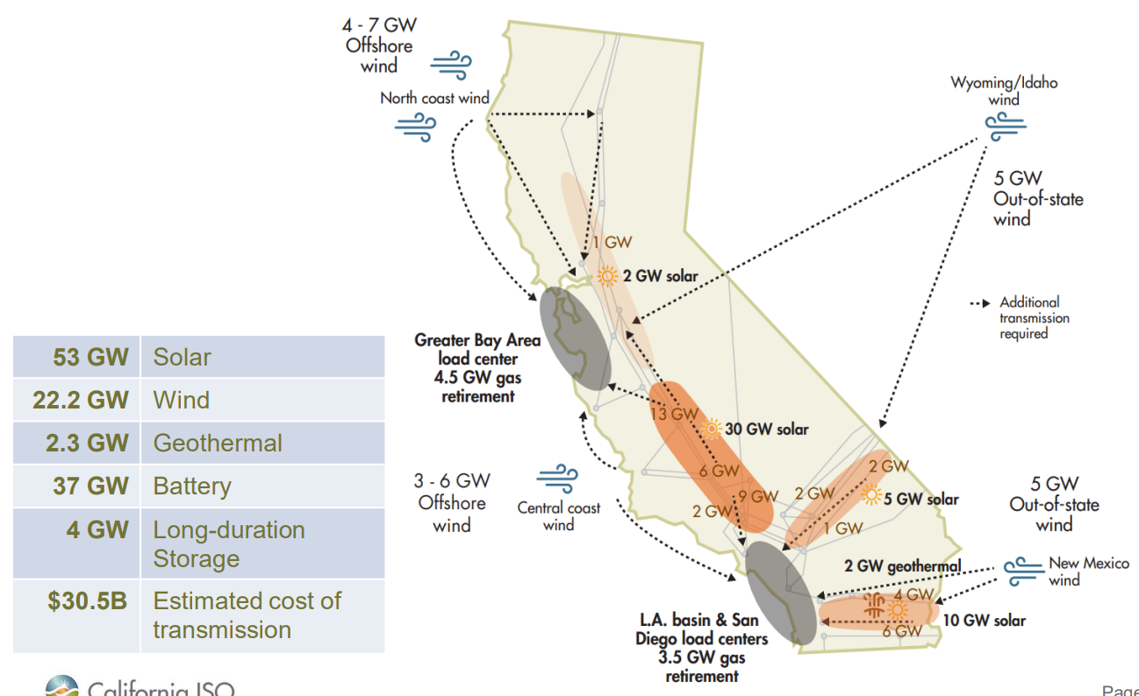
20 Year Transmission Outlook and 2023-2024 Transmission Plan identified the need for greater interregional coordination.
CAISO 20-year Transmission Outlook - 2022
ISO Revised Draft 2023-2024 Transmission Plan

Slide 5
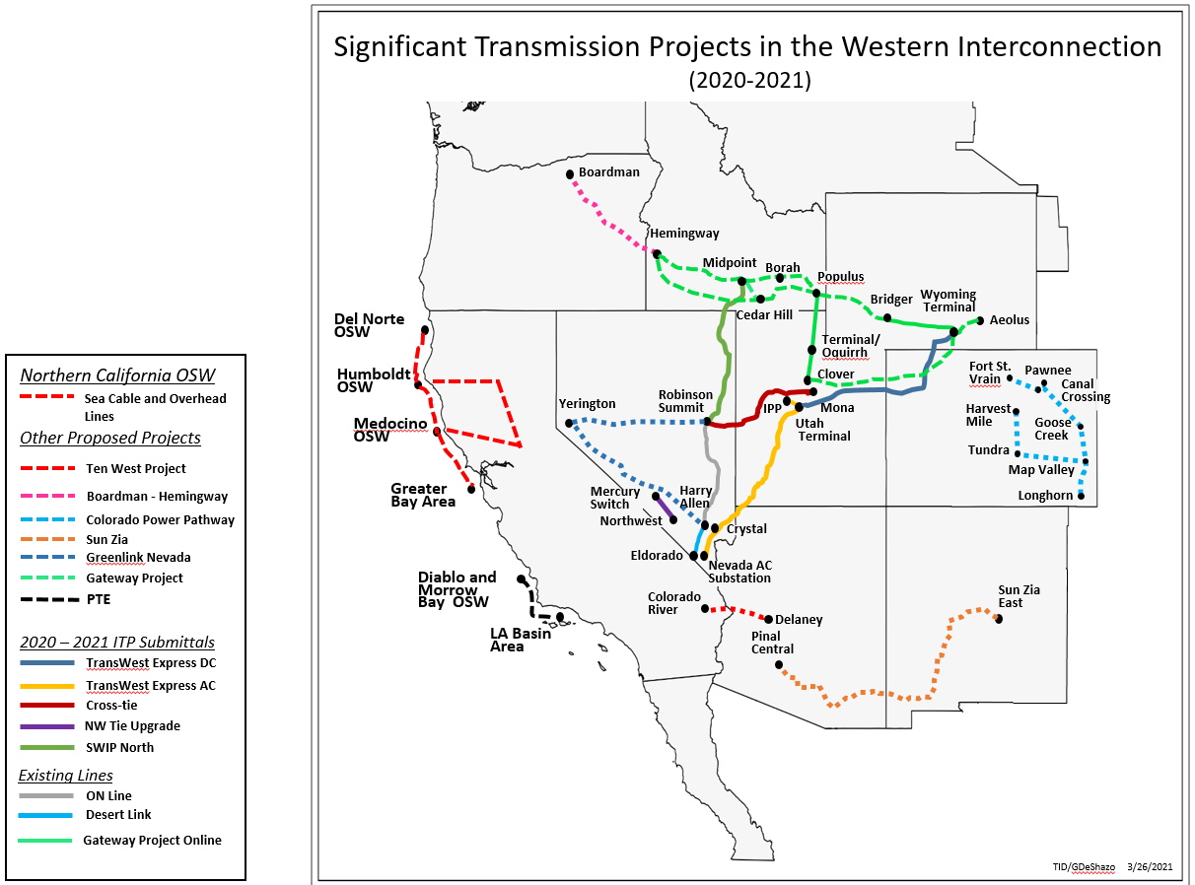
Significant transmission development is needed for growing load and access regional renewables.

Slide 6
We coordinate west-wide transmission planning on multiple tracks.
Information-sharing to support west-wide study efforts
Informal discussions with transmission planning peers
WEIM education and engagement on transmission planning efforts
Creative bilateral efforts to advance projects
Monitor and engage in process reform
Subscriber PTO approach
WECC and NERC system planning studies
FERC technical conferences and comments to NOPRs
DOE National Interest Electricity Transmission Corridor (NIETC) comments
DOE Grid Deployment Office (GDO) loan programs support
Western Transmission Expansion Coalition (WestTEC)
Western States Transmission Initiative (CREPC)
Other bilateral arrangements
FERC Orders
Regional Transmission (Planning) Discussions: PacifiCorp, LADWP, NV Energy, Idaho Power, APS, Portland General
DOE Studies

Slide 7
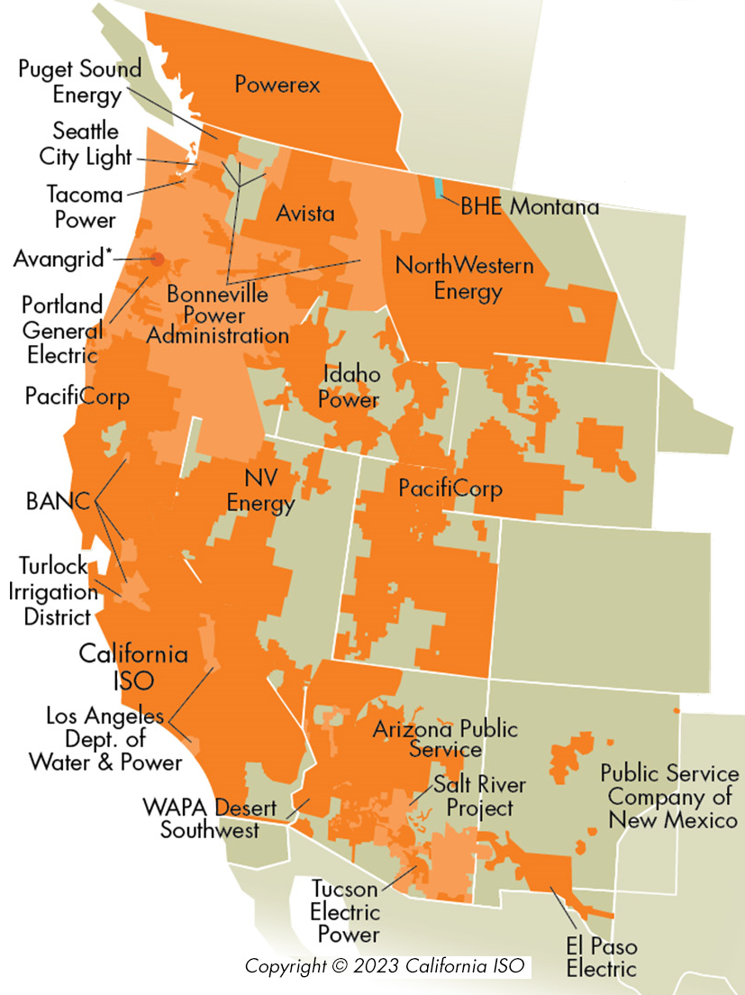
CAISO market updates

Slide 8
Western Energy Imbalance Market (WEIM) providing value to 23 balancing areas across 11 states
Real-time centralized market platform to buy and sell power close to the time electricity is consumed
Voluntary platform, participants retain reliability, transmission and resource planning obligations
Gives system operators real-time visibility across neighboring grids
Manages transmission congestion to produce feasible dispatch that maintain grid reliability and support integration of renewable resource
Provides sub-hourly (15 and 5 minute) economic dispatch of resources, balancing supply and demand, finding least-cost solutions to meet power needs
Makes excess renewable energy available to larger market, avoiding curtailments
Notes:
Add comment on how much NV Energy has saved with WEIM to date

Slide 9
Extension and enhancement of the Day Ahead Market (EDAM) – tariff fully approved by FERC
Optimize supply and demand schedules across the West - the day before the real-time
Remains voluntary (no exit fees), participants retain reliability, transmission and resource planning obligations
Provides system operators day-ahead visibility across neighboring grids enhancing reliability
Enhanced with an imbalance reserve product to manage uncertainty between day ahead and real time
Supports participation in different resource adequacy programs
Situational awareness of supply conditions across the footprint, decreasing risk of emergency conditions
Builds on the WEIM providing incremental economic, reliability, and environmental benefits
Notes:
And verbal comments on GHG, WRAP compatibility, transparency in market data

Slide 10
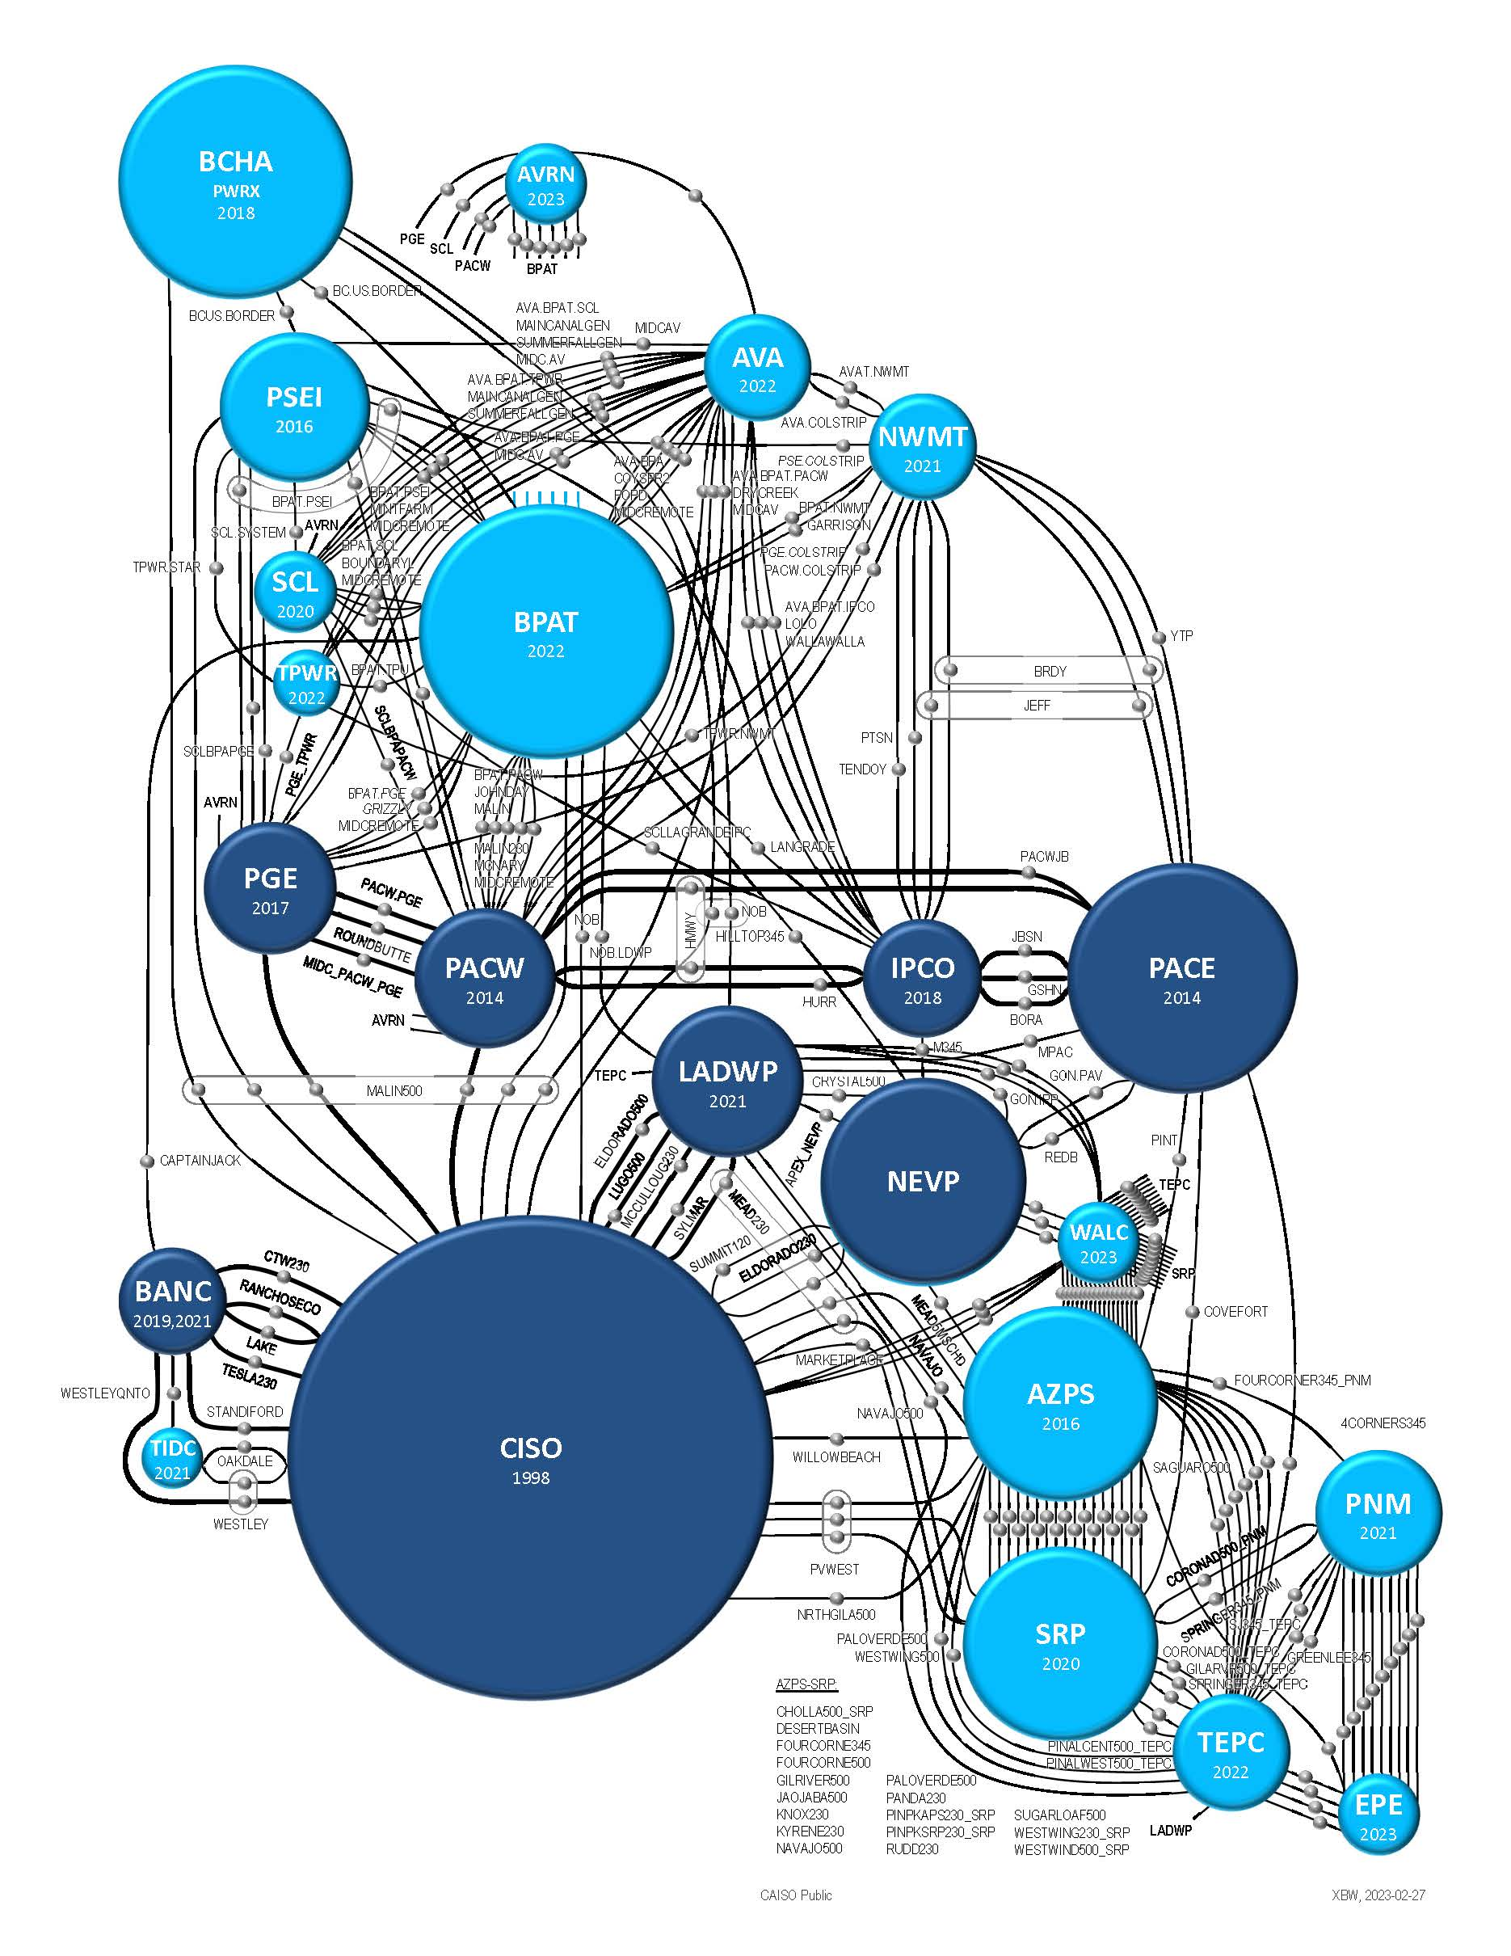
Robust connectivity and existing collaboration through WEIM
ETSR diagram 2026
  Indicating interest in participation in EDAM
  Currently participating in WEIM
Several balancing areas committing to or indicating interest in* participating in EDAM
Covers nearly 50% of the demand in the West
  PacifiCorp
  Balancing Area of Northern California
  Los Angeles Dept. of Water and Power
  Portland General Electric
  Idaho Power Corp*
  NV Energy*
CAISO Public

Slide 11
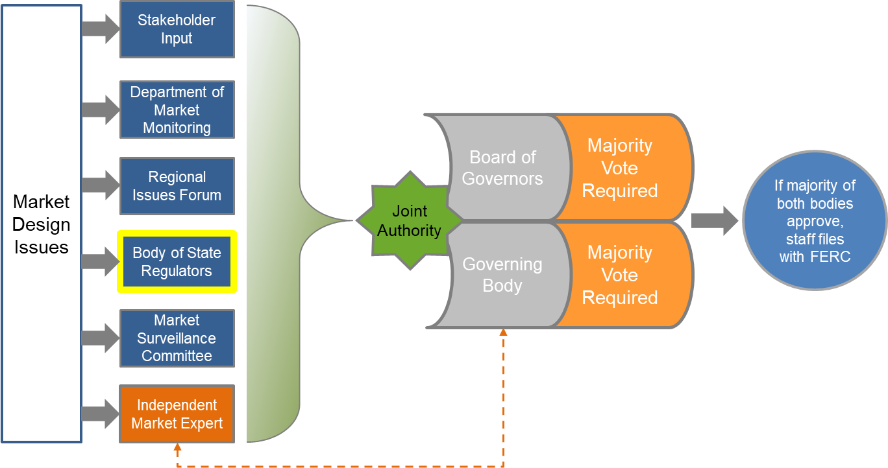
Governance today: Shared authority over regional markets between the ISO Board and WEIM Governing Body

Slide 12
EDAM milestones
PacifiCorp Implementation Agreement
(April 2024)
EDAM operations training available
(Spring 2025)
EDAM
GO-LIVE
(May 2026)
New EDAM Entity Onboarding
(May 2027)
2024
2025
2026
2027
EDAM Market
Simulation
(Sep 2025 – January 2026)
Publish Business Practice Summary
(June 2024)
Business practice development (start April 2025)
Parallel operations prior to go-live (start February 2026)
CAISO Public

Slide 13







Stay connected
California ISO
ISO Today mobile app
California ISO
Daily Briefing
Sign up for
Flex Alerts
Follow us on social media.
CAISO Public

